Slide 1
Welcome to Medicare
Seminar

Slide 2
Before we get started
Who I am
In case of emergency…
Questions
Notes:
Before we get started, I am ___________________ [introduce yourself].
In case of an emergency___________________ [explain instructions, depending on your location].
And, as we talk through things tonight, you may have questions. There is a notes sheet on the top of your items in the packet, if you want to take notes or write down questions as I talk through the slides. I plan to___________________ [mention how you want to handle questions: Do you want to stop at the end of each section? Do you want to wait until the end? Do you just want to answer questions as you go?]

Slide 3

SHIIP (Senior Health Insurance Information Program)
SMP (Senior Medicare Patrol)
Medicare counseling, education, and outreach
Iowa Insurance Division
staff members in Des Moines
~400 trained & certified volunteer counselors across Iowa
SHIIP/SMP services are
free
confidential
objective
Notes:
I want to thank you for coming to our Welcome to Medicare seminar. As I mentioned, I am ____________, and I am a volunteer counselor with the Iowa SHIIP-SMP program. If you’re not familiar with those acronyms, SHIIP stands for Senior Health Insurance Information Program, and SMP is for Senior Medicare Patrol. SHIIP-SMP originally began back in the early 1990’s, in response to an increasing need for Medicare insurance counseling services nationwide. Now the SHIIP-SMP program provides counseling, education, and outreach on Medicare-related health insurances and Medicare fraud.
Our program is housed in the Iowa Insurance Division with a small staff in Des Moines, and almost 400 volunteer counselors, like me, throughout the state. Our volunteers are located at hospitals, clinics, and senior centers, and we are trained to help people understand their options when it comes to Medicare. Most importantly, our services are free, confidential, and objective. We do not sell anything. Our purpose is to provide you with information so you can make informed decisions.

Slide 4
Agenda
Explain
the basic parts of Medicare coverage
Highlight
some of your Medicare choices
Discuss
eligibility and enrollment
Show
available resources & offer some reminders
Provide
opportunity to ask clarifying questions
Notes:
Today, my plan is focus on an overview of Medicare. To do that, I’m going to
explain the basic parts of what Medicare covers
highlight some of your Medicare choices
discuss eligibility and enrollment, and
show you some resources, as well as offer some reminders.
I will also do a quick review of key points at the end of each section. My goal is to spend about an hour on the presentation slides, not including any time for questions.

Slide 5
Explain Medicare coverage
Notes:
The first section of the slides explain what Medicare covers in terms of benefits. I know some of you may be coming to this as a “blank slate” and others of you may be familiar with this from your own experiences with friends or family members, but it is always good to start with the basics of coverage.

Slide 6
Parts of Medicare
“Original Medicare”
A (hospital insurance)
Inpatient hospital
Skilled nursing facility
Home health care
Hospice care
B (medical insurance)
Doctor visits
Outpatient services
Emergency room
Home health care
Medical equipment
C (“Medicare Advantage”)
bundles Medicare Part A, Part B, and often Part D coverage
Medicare benefits managed by private insurance company
D (prescription drug coverage)
variety of plans to choose from based on your prescriptions & pharmacies
Medicare supplement
aka “Medigap”
fills in the “gaps” that Medicare doesn’t cover
sold by private insurance company
Notes:
When it comes to Medicare coverage, Medicare is organized into parts. There’s Medicare A, B, C, and D, and then there are also Medicare supplements.
Medicare Parts A & B were with Medicare from the beginning, and they are referred to as “Original Medicare.” Part A is hospital insurance, which covers an inpatient hospital stay, as well as time in a skilled nursing facility, home health care after a hospital stay, and hospice care. Part B is medical insurance, like doctor’s visits, trips to the emergency room, medical equipment, and general outpatient services.
Then Medicare Part C came along. Known as “Medicare Advantage,” it is another way to receive Medicare benefits. With Medicare Advantage, your coverage is “bundled” into a plan that offers coverage for the other parts of Medicare. So, it bundles your Part A, Part B, and (usually) Part D into one plan. With Medicare Advantage, your insurance coverage is provided and managed by a private insurance company.
Part D provides standalone coverage for your prescription drugs. You can choose from a variety of plans based on your prescriptions and preferred pharmacies.
Lastly, there are Medicare supplements. You may sometimes hear supplements referred to as “Medigap” because it is meant to fill the “gaps” that Original Medicare A & B don’t cover. Medicare supplement plans are also sold by private insurance companies.

Slide 7
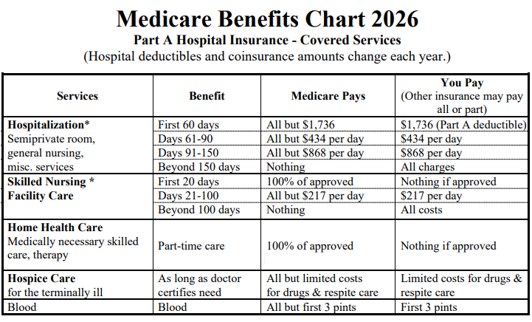
Part A (hospital insurance) inpatient hospital, skilled nursing facility, home health care, hospice
see page 2
Iowa Medicare Supplement & Premium Comparison Guide
Notes:
Now, let’s go into more details about each part of Medicare, starting with Medicare Part A, also known as the hospital insurance. From your packet, please pull out the Iowa Medicare Supplement & Premium Comparison Guide [hold up example copy so they can see the cover]… it looks like this… and open to page 2, which shows the Medicare Benefits Chart for 2026. Part A coverage is listed on the top, and you can see that same chart up here on the screen.
This chart lays out what Medicare Part A covers – time in a hospital or skilled nursing facility, home health care, hospice care, etc. – and shows what Medicare would pay and then what you would be responsible for paying. For example, if you look at the “hospitalization” section, for the first 60 days of an inpatient hospital stay, you would be responsible for a $1,736 deductible and then Medicare would cover the remaining charges. After 60 days, you would have a daily copay, depending on the number of days in your stay.
One thing to know is that Medicare Part A benefits are based on benefit periods. A benefit period begins the first day of an inpatient stay and then it ends once you’ve been out of the hospital for at least 60 days in a row. With each benefit period, your copays and deductible start again, so you could be responsible for the Part A deductible more than once in a calendar year if you have multiple, separate hospital stays.

Slide 8
Part A: premium
Part A is usually premium-free if you have 40+ quarters of work credit
You may qualify through a spouse’s work record
Determinations made by Social Security Administration
Notes:
Medicare Part A is usually premium-free, so you don’t have a monthly charge to receive these benefits, as long as you earned at least 40 quarters of work credit or more. This would be the equivalent of 10 years of work. Even if you don’t meet that requirement, you may be able to qualify through a spouse’s work record. The determination about this benefit is made by the Social Security Administration.

Slide 9
Part B (medical insurance) doctor, outpatient, emergency room, home health care, medical equipment, etc.
yearly deductible
($283 in 2026)
can go to any provider within United States who accepts Medicare
approved amount
Medicare pays 80%
you pay 20%
medically necessary outpatient and preventive services
Notes:
Now let’s move to Part B, which is medical insurance. On that same page of the Iowa Medicare Supplement guide under the Part A chart, there is a Part B benefit chart.
Medicare Part B covers medically necessary outpatient and preventive services, like doctor’s visits & supplies, outpatient hospital treatment, lab tests, home health care not connected to a hospital stay, and medical equipment.
Part B has a yearly deductible that you are required to pay before Medicare covers any Part B services. In 2026, that deductible is $283. When you have Medicare Part B, you can see any provider in the United States that accepts Medicare – that includes any U.S. state or U.S. territory.
And, as long as it’s a Medicare-covered service, Medicare pays 80% of the approved amount, and you are responsible for the remaining 20%.

Slide 10
Part B: preventive services
Some services are covered 100% by Medicare
Welcome to Medicare preventive visit
  within first 12 months you have Part B
Yearly wellness visit
Flu & Pneumococcal (pneumonia) vaccines
Mammograms (screening)
Notes:
Medicare Part B also covers 100% of many preventive services, such as a Welcome to Medicare preventive visit within the first 12 months you have Medicare Part B, a yearly wellness visit, flu and pneumonia vaccines, and other screenings, like mammograms. You do still need to make sure your provider accepts Medicare.

Slide 11
Part B: monthly premium
$202.90/month
(in 2026)
usually deducted from Social Security check
You may get help with Part B premium if BELOW:
(effective 4/1/25)
$1,781/mo. income & $9,660 resources (individual)
$2,400/mo. income & $14,470 resources (couple)
IRMAA: You may pay more for Part B if income is ABOVE:
$109,000/yr individual
$218,000/yr couple (joint filing)
Notes:
With Part B, there is a monthly premium. In 2026, the monthly Part B premium is $202.90 per month, and many people have that directly taken out of their Social Security check. If you are not receiving Social Security, then you can choose to be billed by Medicare, and you can pay by credit card, check, or money order.
Your Part B monthly premium may be higher or lower than $202.90, depending on your income.
Some people may have their Part B premium covered for them if they make below $1,781 per month as an individual or $2,400 per month as a couple and have limited resources. Those amounts will change again April 1, 2026.
Other people may pay more for their Part B premium – this is called IRMAA, or “Income-Related Monthly Adjusted Amount.” In 2026, anyone whose income is above $109,000 per year as an individual or above $218,000 per year as a couple would pay an additional IRMAA amount. In that case, if you are required to pay more, you will be notified through a letter from the Social Security Administration.

Slide 12
Part C (“Medicare Advantage”)
plan manages your Medicare (A, B, D)
plans sold by private insurance companies
review your plan annually
Notes:
Next is Part C, commonly called Medicare Advantage or “MA plans.” Medicare Advantage plans are another way of receiving your Medicare benefits. These are plans sold by federally-approved private insurance companies who then manage your Medicare benefits based on rules set by the Centers for Medicare and Medicaid Services.
Many Medicare Advantage plans also include coverage for your prescription drugs. The Medicare Advantage plan you choose will depend on the plans available in your county, what prescriptions you take, and whether the health care providers you use are in the network for the plan. You can enroll in a plan on medicare.gov, or by calling 1-800-MEDICARE, or by visiting with one of our SHIIP-SMP counselors near you.
You should review your Medicare Advantage plan every year in the fall to make sure you are in the right one for the upcoming year. Medicare Advantage plans can change from year-to-year, and the plan you have this year may not be the best or most cost-effective plan for you the next year.

Slide 13
Part D (prescription drugs)
Covers most outpatient prescription drugs
choose from a variety of plans (14 options in 2025)
sign up on medicare.gov
  or call 1-800-MEDICARE
  or visit with a SHIIP-SMP counselor
review (& possibly switch) your plan each year to make sure you are in the best plan for your needs
Medicare Part D also covers some vaccines with no cost share
shingles, RSV, TDAP (tetanus/diphtheria/whooping cough)
pharmacy needs to be able to bill Part D plan
Notes:
Moving onto Medicare Part D, which is the drug coverage. Part D covers outpatient prescription drugs. The Part D plan you choose will depend on the plans available in Iowa – for example, in 2025, there are 14 options to choose from. You can enroll in a plan on medicare.gov, or by calling 1-800-MEDICARE, or by visiting with one of our SHIIP-SMP counselors near you.
You should review your Part D plan every year in the fall to make sure you are in the right one for the upcoming year based on coverage and costs for your prescriptions. Part D plans can also change from year-to-year, and the plan you have this year may not be the best or most cost-effective plan for you the next year. Not all plans cover all prescriptions.
Medicare Part D also covers some vaccines at no charge, like the shingles, RSV, or TDAP vaccines. You just need to make sure the pharmacy – or wherever you get the vaccine – can bill your Part D plan.

Slide 14
Part D: monthly premium
range of premiums
($4.70 to $140.20 in 2026)
deduct from Social Security check or pay plan directly
Extra Help: You may get assistance with Part D payments if BELOW:
$2,015/mo. income & $18,090 resources (individual)
$2,725/mo. income & 36,100 resources (couple)
IRMAA: You may pay more for Part D if income is ABOVE:
$109,000/yr individual
$218,000/yr couple (joint filing)
Notes:
Like Medicare Part B, Part D has a monthly premium. But unlike Medicare Part B, the monthly premium depends on the plan. In 2026, the plan options range from just under $5 per month to $140 per month, depending on the plan you choose. And you can pay the plan directly or you can have the monthly premium deducted from your Social Security.
Similar to Medicare Part B, you may pay more or less depending on your income. If your income is below $2,015 per month as an individual or $2,725 per month as a couple, you may be able to get benefits through the “Extra Help” program to assist with your prescriptions. Our SHIIP-SMP counselors can help you apply for the Extra Help program if you qualify.
Or you may have an additional IRMMA amount to pay beyond the plan premium if your income is above $109,000 as an individual or over $218,000 as a couple. Social Security will send you a letter notifying you that you have an additional Part D IRMAA payment. In this case, though, the additional amount goes to Medicare, not to the Part D plan. So, in this case, you may have two bills for your prescription plan – one from Medicare, and one for the plan itself. It’s important to pay the extra amount because if you don’t, you could be disenrolled from your drug plan and left without coverage for your prescriptions.

Slide 15
Medicare supplement
supplement fills the “gaps” of Medicare A & B
pay premium in addition to Part B & Part D premiums
not necessary if you have Medicare Advantage plan
Notes:
The last piece we will discuss is Medicare supplements. These are sold by private insurance companies to supplement or “fill the gaps” for Medicare Part A & B. If you have a Medicare supplement, you pay an additional premium on top of your Part B and Part D premiums. Your supplement then covers charges that Medicare doesn’t, such as the Part A deductible or the remaining 20% coinsurance for Part B services.
With a supplement, if Medicare doesn’t cover a service, then the supplement doesn’t either. It’s meant to work with Original Medicare A&B. A supplement is not necessary if you have a Medicare Advantage plan as you would not have Original Medicare.
We will talk more about both Medicare Advantage plans and Medicare supplements in a couple minutes when we discuss Medicare coverage choices.

Slide 16
Review: Medicare coverage
The parts of Medicare:
  A - hospital & skilled nursing facility, etc.
  B – doctor/outpatient, equipment, preventive services, etc.
  C – Medicare Advantage plan (A, B & D)
  D - prescription drugs
Each part has their own costs – monthly premiums, deductibles, copayments, etc.
Notes:
So, to review this first section before we move on:
Medicare Part A covers hospital and skilled nursing facilities, as well as home health care after a hospital stay, and hospice care
Part B covers outpatient treatment & medical equipment, doctor visits, and preventive services
Part C is when someone enrolls in a Medicare Advantage plan to receive their A, B, and usually D benefits.
Part D is prescription drug coverage through a separate plan you choose based on your costs and prescriptions
For most of the parts of Medicare (especially B, maybe C, and D), you usually pay a monthly premium, and that premium may be higher or lower, depending on your income.
You may also pay deductibles and copayments on top of the monthly premiums, unless you have a Medicare supplement to cover those charges.

Slide 17
Highlight your Medicare choices
Notes:
Next, let’s talk about some of the choices you can make when it comes to Medicare.

Slide 18
Available choices for your Medicare “path”
Original Medicare (Parts A & B)
+ Part D (prescription drug) plan
+ Medicare supplement
Medicare Advantage (Part C)
Notes:
One choice is which “path” you will take: Are you going to take the “Original Medicare” path and choose a Part D plan and supplement? Or are you going to take the Medicare Advantage path?
Which path you take really depends on your situation… what your health is like, where you go to the doctor or hospital, how much you can afford to pay for health insurance each month. But it is important to understand that you can't always switch from one path to the other and back. You do have limited opportunity to try out a Medicare Advantage plan and then switch back to Original Medicare – if you want – but this can only be done once.
So sometimes you might be able to move from one path to the other, whereas other people might take the same Medicare path their whole lives.

Slide 19

Original Medicare &
Medicare supplement
supplement fills the “gaps” of Original Medicare A & B
pay premium in addition to Part B & Part D premiums
sold from an insurance company
6-month one-time window to choose without underwriting
  starts with Part B effective date
  for anyone age 65+
Notes:
Part of the reason you can’t always switch Medicare “paths” is because there are some rules with Medicare supplements. As I mentioned earlier, supplements are plans sold from insurance companies and you pay them a premium on top of your Medicare Part B premium. Then the supplement fills the “gaps” in Original Medicare.
Starting with the date your Part B goes into effect, you have a one-time, six-month window to choose a supplement without any underwriting. Which means they cannot turn you down based on your health. And that window is only available to those on Medicare due to age. Anyone on Medicare due to disability has to wait until age 65 for this opportunity to choose any supplement you want.
This means that if you leave a supplement, you may be denied if you try to come back to it, depending on your health situation. Medicare supplements aren’t something you can easily change year-to-year like a Part D plan or Medicare Advantage Plan. We often say you “marry your supplement and date your drug or Medicare Advantage plan.”

Slide 20
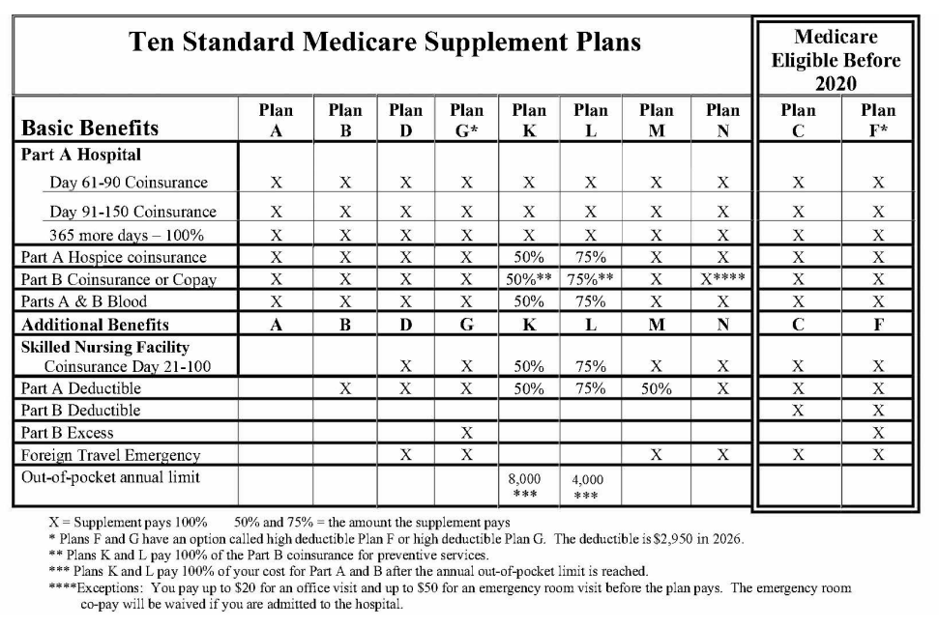
Medicare supplement options
Medicare supplements have standardized
plan letters
see page 3:
Iowa Supplement & Premium Comparison Guide
Notes:
Let’s now go to page 3 of the Iowa Medicare Supplement guide, where you can see different Medicare supplement options. Medicare supplements are standardized by plan letters, like A, B, D, G, etc. And if you look down the chart, you will see an “X” marking what each plan offers. For example, you can see that Plan A offers the fewest benefits while Plan G offers the most. All supplements will cover your daily coinsurance for hospital stays under Part A, as well as most or all of your Part B coinsurance for the 20% that Medicare doesn’t cover for your Part B services.
When you are buying a plan, you should know that no matter which company sells you the plan, the benefits will be the same. So, a plan K is a plan K, no matter which company you purchase it from. But while benefits will be the same, the premium costs will vary between companies. Companies also tend to offer different rates for males versus females or smokers versus nonsmokers, and some even offer household discounts. Your age at which you purchase the plan will also impact the cost.
To buy a supplement, once you have a Medicare number and are enrolled in both A & B, you can contact the company directly or reach out to an insurance agent.

Slide 21
Choosing a prescription drug plan
What is the monthly premium & yearly deductible?
Are all my prescriptions covered in plan’s formulary?
What copayments will I be responsible for?
Is my insulin covered at $35/month?
What pharmacies are preferred or offer the best costs?
Are there any restrictions from the plan for my medications?
Notes:
The other coverage that goes along with Original Medicare A&B is a Part D plan for prescription drug coverage. When it comes to choosing a drug plan, there are a variety of questions to consider, like:
What is the plan’s monthly premium or yearly deductible?
Are all your prescriptions covered by the plan?
What additional co-payments will you be responsible for throughout the year?
If you take insulin, is it covered at $35 per month?
What pharmacies in your area offer the best costs with that plan? And can you use pharmacies outside of Iowa or mail-order pharmacies?
Lastly, are there any other restrictions by the plan on your medications? This could include limits on quantities of certain medications or needing to get pre-authorization from your doctor.

Slide 22
Available choices for your Medicare “path”
Original Medicare (Parts A & B)
+ Part D plan
+ Medicare supplement
Medicare Advantage (Part C)
Notes:
As mentioned earlier, if you don’t take the Original Medicare path, your other “path” is Medicare Advantage.

Slide 23

Medicare Advantage (Part C)
Another way of receiving Medicare benefits (A, B, and usually D)
Biggest differences: Medicare Advantage
Must live where the plan is offered
“Pay as you go” versus monthly premium
Plan will manage your Part A & Part B benefits
Stick to network (doctors/hospitals) for maximum benefits & lowest costs
Pre-authorizations may be needed for services
May include drug benefits and extra benefits like dental or vision, etc.
You do not need a supplement AND
Medicare Advantage plan
Notes:
For the Medicare Advantage path, we have another booklet called the Medicare Advantage & Other Health Plans in Iowa. You can also find that in your packet. [give them minute to pull it out?]
Medicare Advantage plans are required to offer the same basic Medicare Part A & B services as Original Medicare, and most plans include Part D drug coverage. If you enroll in a Medicare Advantage plan, then you would use the plan card for your healthcare benefits instead of your red, white & blue Medicare card.
Some of the biggest differences between Original Medicare and Medicare Advantage are that:
With Medicare Advantage, you need to live where the plan is offered (it needs to be available in the county where you live).
Many Medicare Advantage plans don’t have a monthly premium, so instead of paying a set amount each month, you “pay as you go” based on services received. This could include co-pays for things such as for doctor visits or lab work.
The plan will manage your Part A & Part B benefits, and each plan has its own network of doctors and hospitals. If you go outside of that network, you may have to pay more (or all) of the charge.
Many times, a pre-authorization is required through the plan for services before you receive them.
Most Medicare Advantage plans offer additional benefits that Original Medicare doesn’t, like dental or hearing or vision coverage.
Remember that if you have an MA plan, then you do not need a Medicare supplement too.

Slide 24
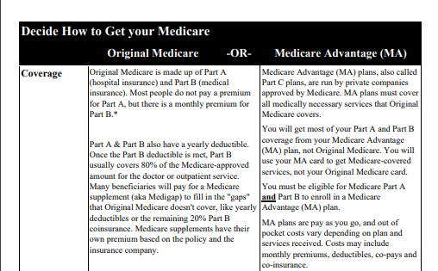
Should your “path” be Medicare Advantage or Original Medicare with a supplement?
See Medicare Advantage guide
Things to consider before you enroll in a Medicare Advantage Plan (page 5)
Checklist for people considering a Medicare Advantage Plan (page 6)
Decide How to Get Your Medicare chart (page 7)
Medicare Advantage plans available in Iowa (page 9)
Notes:
The Medicare Advantage guide talks through your different options for Medicare Advantage plans each year. And it is sectioned into the different types of Medicare Advantage plans.
If you’re not sure whether you want to go with a Medicare Advantage plan or stick with Original Medicare, there are some helpful resources in the guide:
Pages 2 to 9 walk you through the different things to consider when deciding whether to stick with Original Medicare or enroll in a Medicare Advantage plan. If you look through those pages, we have an explanation on what Medicare Advantage plans are and how you enroll… [might want to slow down or pause as they look]…a trial period that is available to you if you enroll in a Medicare Advantage plan for the first time … how Medicare Advantage plans work with Part D… and things to consider before you enroll in a Medicare Advantage Plan…
There is even a checklist to go through on page 6… and a chart comparing the differences between Original Medicare and Medicare Advantage starting on page 7… and on page 9, it lists the different kinds of Medicare Advantage plans, if you want to know the difference between an HMO plan versus a PPO plan versus a Cost plan, for example.
These are the kinds of things our SHIIP-SMP volunteer counselors would talk through with you in more detail at an appointment or through a phone call, if needed.

Slide 25
Review: Your Medicare choices
You can have Original Medicare & a supplement with a Part D plan OR a Medicare Advantage plan
Once your Part B starts, there is a 6-month window (for anyone 65+) to choose supplement without health questions
With Medicare Advantage, the plan manages your care (pre-authorizations, networks of providers, etc.)
If you’re in a Medicare Advantage plan, you use their plan card, but keep your Medicare card in safe place!
Notes:
So, to review, one of the biggest Medicare choices you will need to make is which path to take: Original Medicare with a Medicare supplement and Part D plan, or a Medicare Advantage plan. Remember that once your Medicare Part B goes into effect, you have a one-time, six-month window to choose a supplement without any underwriting. Which means they cannot turn you down based on your health.
Medicare Advantage plans are another option for you to receive your Medicare services, and many plans offer additional services that Original Medicare doesn’t. With Medicare Advantage your care will also be managed by the plan with pre-authorizations needed for many services and different provider networks based on the plan.
One last thing to remember is if you are in a Medicare Advantage plan, you use the plan’s card for your healthcare services, but you should still keep your red, white, and blue Medicare card, just in case.

Slide 26
Discuss Medicare eligibility & enrollment
Notes:
We’ve talked about what Medicare covers and what some of your options are. Before we start wrapping this all up, let’s talk about how you become eligible for and enroll in Medicare. Then we’ll have some time for questions.

Slide 27
Initial Medicare eligibility
when you turn 65
on 25th month of disability benefits (under age 65)
except for people with ALS or ESRD
(their benefits start earlier)
Notes:
Medicare eligibility starts for many people when they turn 65. For others, it might start before 65, if they have received disability benefits for 24 months, or have been diagnosed with ALS (also called Lou Gehrig’s disease) or ESRD (End Stage Renal Disease).

Slide 28

Initial Enrollment Period (IEP)
7-month window right before and right after your eligibility begins (usually 3 months before & after your 65th birthday)
This is an important time to make some decisions, especially if you will continue working and/or have health coverage other than Medicare
*month your eligibility begins*
(usually your birth month)
Notes:
When you are first eligible for Medicare, you have what’s called an Initial Enrollment Period, or IEP. It is a 7-month window from three months before to three months after your month of birth (or your 25th month of disability payments).
If you sign up for Medicare before your birth month (or 25th month of disability payments), then Medicare becomes effective the start of that month. Otherwise, if you sign up during any of the next three months, your effective date will be the first of the month following the month you enrolled.

Slide 29
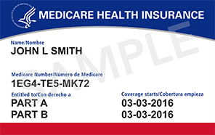
Enrollment
Enrollment in Medicare A & B is automatic if you are drawing Social Security or Railroad Retirement benefits
Card should arrive in mail about 3 months before eligibility begins
Otherwise: You enroll yourself with Social Security Administration or Railroad Retirement Board
(In this case, plan ahead!)
Notes:
Medicare eligibility and enrollment is handled by the Social Security Administration, and enrollment into Medicare A and B is automatic if you are drawing Social Security or Railroad Retirement benefits at age 65. If you are enrolled automatically, you should get a red, white, and blue Medicare card in the mail about 3 months before you are eligible for Medicare.
If you are not already receiving Social Security or Railroad Retirement benefits when you turn 65, you will need to apply for Medicare. You can apply for Medicare by contacting Social Security. Railroad Retirees will need to contact the Railroad Retirement Board. If you are applying for yourself, we recommend starting the process at least 3-4 months before your 65th birthday.

Slide 30
If you are Medicare-eligible & retired
(and not covered by working spouse)
Enroll in Medicare A (hospital) & B (medical)
Enroll in additional coverage at www.medicare.gov or 1-800-MEDICARE or with assistance from SHIIP-SMP volunteer
  Part D (drug) plan + Medicare Supplement (6-month window with no underwriting), or
  Medicare Advantage plan (Part C)
Protect your Medicare card
Make sure all monthly premiums are paid
Medicare is always primary if you have retiree coverage
Notes:
When most people start Medicare, it will be their primary insurance – especially if you are retired when you become eligible for Medicare and you aren’t covered by health insurance from a working spouse. When there isn’t active employment, then Medicare is primary.
When you start Medicare, you will want to make sure you are enrolled in Medicare A & B. You will then need to decide if you will stay with Original Medicare and enroll in a Part D drug plan and Supplement, or select the Medicare Advantage path. Remember that if you choose a supplement, you will have six months from your Part B effective date to sign up for a Medicare supplement without any denial due to health issues.
Again, you can go to www.medicare.gov or call 1-800-MEDICARE or meet with your closest SHIIP-SMP volunteer site for assistance with most plan enrollments.
You will also want to keep your red, white, and blue Medicare card safe. Make sure your monthly Part B premium is paid on time. As well as any additional premiums from a Part D plan, Supplement, or Medicare Advantage Plan.
Even if you have coverage through a retiree plan, Medicare will always be your primary coverage.

Slide 31

If you are 65 & still working
You may want to delay parts of Medicare
  if covered through active employment (you or spouse)
Current employer is primary coverage when there are 20+ employees*
  Employers with less than 20 employees may choose NOT to provide coverage
*100 employees if on Medicare due to disability
Notes:
People working past 65 have additional options and decisions with Medicare. If you are 65 or older and have insurance through active employment, Medicare may be your secondary insurance and you may want to delay parts of Medicare enrollment. You may also want to delay Medicare enrollment if you are covered by a spouse who is still working. It all depends on healthcare coverage through active employment when you are first eligible for Medicare.
Employers with 20 or more employees: You must be allowed to stay on the employer plan as primary insurance past the age of 65. But if the employer has less than 20 employees, they can decide if they will continue providing coverage after the employee (or their spouse) turns 65.
And for people who are on Medicare due to disability, the number is 100. Over 100 employees, and you can stay on the employer insurance as primary. Under 100 employees, the employer plan can choose if they will continue providing coverage.

Slide 32
Delaying Medicare?
You may want to delay parts of Medicare. You can delay:
Part A if you have an HSA (Health Savings Account)
  HSA contributions & enrollment in Medicare can create tax problems
  If you do delay, enrollment will be backdated 6 months
Part B if you have coverage through active employment
  Save yourself the Part B premium for now
  Do this BEFORE Part B goes into effect
  If you receive Medicare card automatically, follow instructions on back of card
Part D if you have drug coverage that’s as good as Medicare’s
  Keep any proof of current drug coverage (ex: employer documents)
  Part D eligibility is triggered by Part A effective date
Notes:
As I mentioned on the previous slide, if you have insurance through active employment – that could be you or a spouse who is still working – you may decide to delay parts of your Medicare coverage when you are first eligible:
You may choose to delay Medicare Part A if you have a Health Savings Account (HSA). Enrolling in Part A while still making contributions to a HSA may create a tax penalty. Your Part A effective date is typically backdated six months (up to your 65th birthday).
Many people delay Medicare Part B when they have adequate coverage through active employment (their own or through a working spouse). Delaying means you will not need to pay the monthly Part B premium. The key is to do this before your Part B goes into effect so you can also delay the six-month window when you can enroll in a supplement without passing health underwriting.
Lastly, you can also delay Part D drug coverage if you have a drug plan that’s as good as what Medicare provides. Enrolling in Part D plan is “triggered” by when your Medicare Part A begins, so save any “proof” about your drug coverage to avoid any late enrollment penalties later when you enroll in a Medicare drug plan.

Slide 33

Special Enrollment Period (SEP)
Once you or spouse retires, you have limited time to make some choices without penalty
2 months to enroll in Part D
and choose drug plan
8 months to enroll in Part B
6 months (from Part B effective date) to choose a supplement without health underwriting
Notes:
Later, once you (or your spouse) retires, or if you get dropped by your employer plan, you have a special enrollment period where you have a limited time to fully enroll in Medicare without penalty. Unfortunately, the timelines aren’t all the same. Once you retire, you have:
two months to enroll in a Part D drug plan
up to 8 months to enroll in Part B
If you miss those deadlines, you may have to pay late enrollment penalties.
And, once your Part B goes into effect, then you have six months to choose any supplement without being denied due to any health conditions.
Of course, these are just Medicare’s guidelines. If your current coverage ends as soon as you retire, it’s best to enroll in Medicare ahead of time so you aren’t left with any gaps in coverage.

Slide 34
Review: Medicare eligibility
& enrollment
Automatically enrolled in Medicare if receiving Social Security
If you have coverage through active employment, you may be able to delay parts of Medicare
Limited time to make choices once you retire (or person covering you retires)
Retiree insurance is always secondary to Medicare
If you are eligible for Medicare under age 65, you “start over” once you turn 65
Notes:
To review some critical information things about eligibility and enrollment, you are eligible for Medicare if you are:
turning 65 or
have received disability benefits for 24 months or
been diagnosed with ALS or ESRD for a certain amount of time.
And you will be automatically enrolled in Medicare if you are receiving Social Security. Otherwise, you should enroll yourself with the Social Security Administration.
If you are going to continue to work (or be covered by a working spouse), and will have employer health insurance, you can delay parts of Medicare, but it is best to make those choices before your Medicare becomes effective. And check with Social Security before delaying Medicare, since they handle Medicare eligibility and enrollment.
Once you retire, you have limited time to fully enroll in Medicare – otherwise, you might have to pay lifetime penalties. But, if you’re starting Medicare and you’re already retired, Medicare is your primary and the retiree insurance is secondary.
Lastly, for anyone who is eligible for Medicare under 65 due to disability, your eligibility “starts over” once you turn 65 and you can review your Medicare choices again, like for a Medicare supplement.

Slide 35
Show resources & offer reminders
Notes:
Before I take questions, I want to end by offering some important reminders and showing some resources available to you.

Slide 36
Preventing Medicare fraud
“Guard your card”
Don’t answer unknown calls, but track if you do talk to someone
Open your mail & report unexpected healthcare packages
Review your Medicare notices for proper charges & services
Notes:
First, I want to offer important reminders about Medicare fraud and abuse. Unfortunately, every year, hundreds of thousands of people are impacted right here in Iowa by Medicare fraud. And there are some things you can do to prevent this from happening to you:
Tip #1 is to “guard your card.” Treat it like your Social Security number and don’t give your Medicare number out to anyone other than your healthcare providers or the people in your life that you trust to make healthcare decisions. And definitely don’t give your Medicare number out over the phone. Medicare will NEVER call you to ask for your Medicare number or personal medical information.
Tip #2 is to screen your calls. Don’t answer unknown callers. Make them leave you a message first. And when you do talk to someone, whether it’s an insurance agent or someone at Social Security, keep track of who you talked to. Write down the name & date & what you discussed.
Tip #3 is to open all your mail. This is how you are contacted by Medicare, by Social Security, and by Health & Human Services or Medicaid. Open your mail, read it, and notify someone if you have questions or something doesn’t look right. Same thing if you receive a healthcare package in the mail you weren’t expecting. Recent Medicare scams have involved sending out things you didn’t order, like COVID test kits or catheters.
Tip #4 is to review your Medicare statements (MSNs) & explanation of benefits documents for charges & services you actually received. Another common scam is for the wrong charges or supplies to end up on someone’s Medicare statement. So, pay close attention to what you’re receiving in the mail and what health services are being charged to your Medicare account.
For any of these situations, if something doesn’t seem right, contact 1-800-MEDICARE or us at SHIIP-SMP and we will help you report the issue, if needed.

Slide 37
Fraud Update
Current Medicare Scams
COVID Test Kits
Catheters
Continuous Glucose Monitors (CGMs)
Genetic Testing
DME – braces
CPAP supplies
Telehealth
If you suspect fraud:
Call SHIIP-SMP to report it
Contact Medicare and request a new Medicare number by calling 1-800-633-4227
  Unknown charges on your Medicare account are a symptom of a compromised Medicare number
  You are entitled to a new Medicare number if your number is compromised
Notes:
Some of the common, current Medicare scams happening right now involve:
COVID test kits
Catheters
continuous glucose monitors
genetic testing
durable medical equipment – especially knee or back braces
CPAP supplies, and telehealth
If you have any of these items sent to you unexpectedly or if you notice any of these charges on a Medicare Summary Notice and suspect it is Medicare fraud, contact us at SHIIP-SMP to report it, but you will also want to call Medicare at 1-800-633-4227 to request a new Medicare number. Unknown charges are a symptom of a compromised Medicare number, and you are entitled to a new Medicare number if your current Medicare number is used fraudulently. The fastest way to get that new Medicare number is to call Medicare so that your old Medicare number doesn’t continue to be billed for services you didn’t actually have.

Slide 38
Avoid being denied for medical care
Medicare offers a continuous glucose monitor (CGM) benefit only once every five years
CGM claims that aren’t reported to Medicare as fraud can prevent beneficiary from receiving one in the future—even if it is medically necessary
Notes:
An important reason why you want to make sure you report Medicare fraud and request a new Medicare number is because there are some services Medicare will only cover on certain timelines. For example, Medicare only offers coverage for a continuous glucose monitor (CGM) once every five years, so if there is a CGM billed to your Medicare account fraudulently and not reported, it could affect whether you are able to have one covered by Medicare in the future, even if it is medically necessary and you now need one.
Making sure your Medicare account is only charged for services & equipment you actually received is an important way to make sure you can continue to receive the services you need, when you need them.

Slide 39

www.medicare.gov
Create an account
track claims
print Medicare card
search for providers
enroll in plan (Part D or Medicare Advantage)
You can also find detailed benefit documents for all drug & MA plans
Notes:
Tracking your Medicare coverage online can be an easy way to keep track of your services too.
The Medicare website medicare.gov is very useful because you can create a personal account with your Medicare number to track your Medicare claims, print a copy of your Medicare card, search for providers, and change Medicare Advantage or drug plans each year. You can also find details about coverage & benefits for different plans, as well as contact information for the plans.

Slide 40
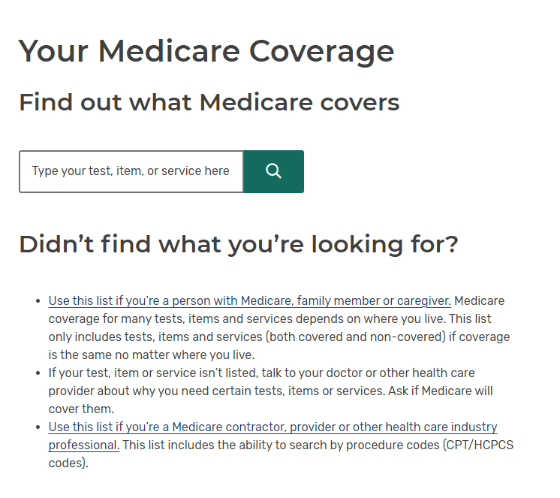
Questions about what Medicare covers?
www.medicare.gov/coverage
Notes:
Medicare.gov also has lots of details about what Medicare does and doesn’t cover. You can type in www.medicare.gov/coverage, enter a test or service and see whether it’s covered. Note that this is more on the “Original Medicare” side, though. When it comes to a Medicare Advantage plan, you should call the phone number on your plan’s card or check the plan’s website for information about coverage of services or tests.

Slide 41

Iowa SHIIP-SMP is here for you!
Call our statewide consumer line
1-800-351-4664
Visit our website at shiip.iowa.gov
Find your local site (“Find a counselor”)
Read more about Medicare coverage (“Find Resources”)
Notes:
Another resource is us at the SHIIP-SMP program. This presentation is not the entirety of the services we offer. You can access us our services and information in a variety of ways:
You can visit our website at shiip.iowa.gov. (Note that “ship” has 2 I’s!) At the top of that website, you can click “Find a counselor,” then type in your county to find your local site where we have volunteers set up to meet with you or discuss things over the phone. On our website, you can also click “Find resources” at the top to access a variety of documents like the ones in your packet today.
You can also call our consumer line at 1-800-351-4664. That is a toll-free number where we can answer general questions and get you to a local SHIIP-SMP site, if needed.

Slide 42

Iowa SHIIP-SMP is here for you!
Subscribe to our newsletter
Go to shiip.iowa.gov/contact
Scroll to the bottom and sign up for our email notifications
Notes:
SHIIP-SMP has a quarterly newsletter we email out with timely articles about what’s going on in Medicare. You can sign up for the newsletter by going to shiip.iowa.gov/contact. Then scroll to the bottom of the page and subscribe to our email notifications.

Slide 43

Iowa SHIIP-SMP is here for you!
Follow our Facebook page
avoiding fraud
enrollment periods
preventive benefits
… and more!
Notes:
We also have a Facebook page called the Iowa Senior Health Insurance Information Program & Medicare Patrol. We post reminders there throughout the year, like ways to avoid Medicare fraud, enrollment periods you might be eligible for, what preventive benefits to schedule with your doctor, etc.

Slide 44
Your local SHIIP-SMP site
[enter your information here]
Notes:
SHIIP-SMP volunteers are trained to provide one-on-one counseling to talk through your options, compare Medicare Advantage & Part D plans, and make sure you feel comfortable with your coverage decisions. Please call us to make an appointment with a volunteer counselor at your local site. Your local site is located at _______________, and the number there is __________________.

Slide 45

We would love for you to join the SHIIP-SMP program.
Please come talk to me about being a volunteer!
Notes:
We recruit new volunteers each year, so if you are ever interested in volunteering for the SHIIP-SMP program, please come talk to me.

Slide 46
Questions?
Notes:
In addition to some of the items I already mentioned, in your packet tonight, you have… [mention some of the other things in the packet].
Are there any remaining questions?

Slide 47
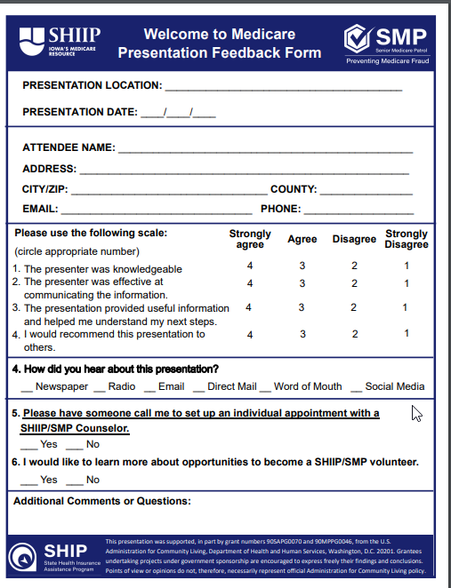
One last thing: Please fill out evaluation
Notes:
Before you leave, please complete the SHIIP-SMP Presentation Feedback Survey.

Slide 48
Thank you!
Notes:
Thank you for coming!

